Slide 2
1
PROJECT SCHEDULE
2
DESIGN PHASES
3
SCHEMATIC DESIGN

Slide 3
1 PROJECT SCHEDULE

Slide 4
PROJECT SCHEDULE – DESIGN PHASE
July – September 2020 Programming / Preliminary Design
October – November 2020 Schematic Design – “Exploration”
December – February 2021 Design Development – “Refinement”
Act 34 Public Hearing
March – April 2021 Construction Documents – “Preparation”
Note:
Board Action required at end of each Design Phase
Schedule is pending Municipal and Regulatory Agency Approvals
Estimated Start of Construction in July 2021

Slide 5
BOARD UPDATES & APPROVALS
December 3, 2020 Board Approval: Schematic Design
January 11, 2021 Board Review of Building DD Phase
February 8, 2021 Board Review of Building DD Phase
March 8, 2021 Board Approval: Design Development & Act 34 Booklet
April 12, 2021 Board Approval: Release Project for Bidding
May/June 2021 Tentative Bid Receipt
June 2021 Board Approval: Intent to Award
July 2021 Issue Notice to Proceed: Start Construction

Slide 6
ACT 34 PUBLIC HEARING SCHEDULE
Step #1 Board Approval of Maximum Building Construction Cost / Review Draft Act 34 Booklet
Step #2 Architect submits Act 34 Booklet to PA Department of Education for review and approval to advertise
Step #3 School District and Solicitor coordinate advertisement 20 days prior to Hearing date
Step #4 Act 34 Public Hearing, conducted by School District, Solicitor, Architect and Financial Consultant
Step #5 End of 30 day waiting period to compile proof of publication, written comments and Hearing minutes

Slide 7
2 DESIGN PHASES

Slide 8
NOTE: The images in the upcoming slides do not represent the design of the Chicora Elementary School additions and renovations. These example images are used to illustrate project development and detail throughout the various design phases.

Slide 9
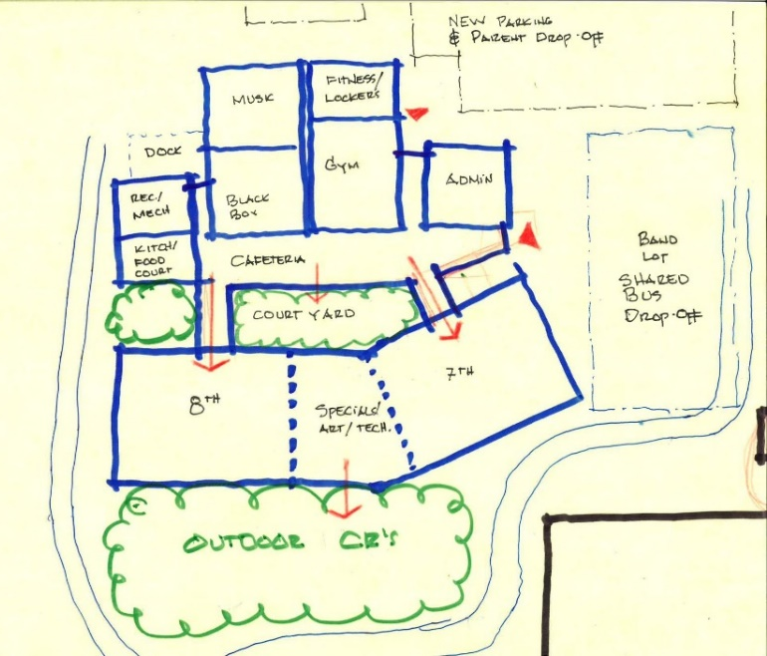
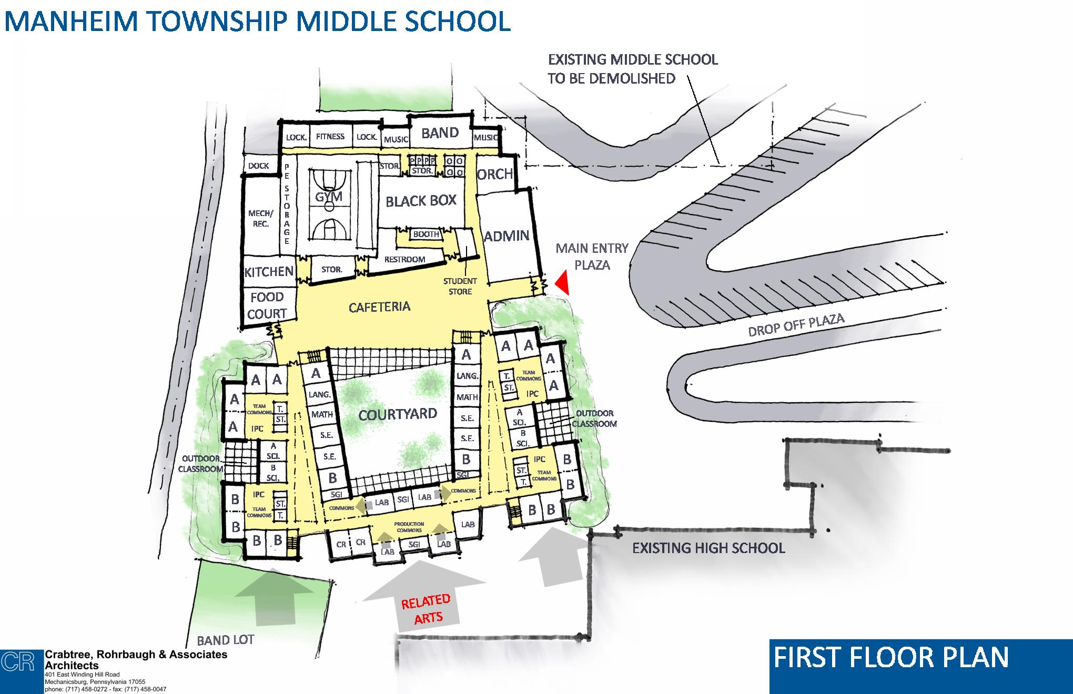
Schematic Design Phase
1. Programming:
Document Educational Program.
2. Site Analysis:
Establish Project Goals and Site Considerations, Site Survey of Existing Conditions, determine necessary approvals.
3. Conceptual Plans:
Establish Building Organization, Prioritize Program and Site Adjacencies and Develop Traffic Circulation.
4. Schematic Plans:
Develop Floor Plans based on Educational Program and existing site conditions
PROJECT EXAMPLES

Slide 10
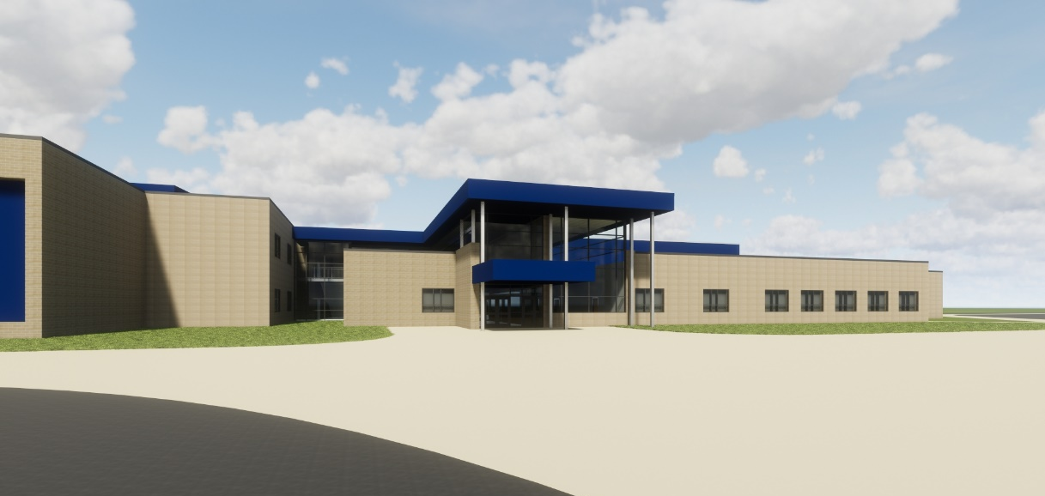
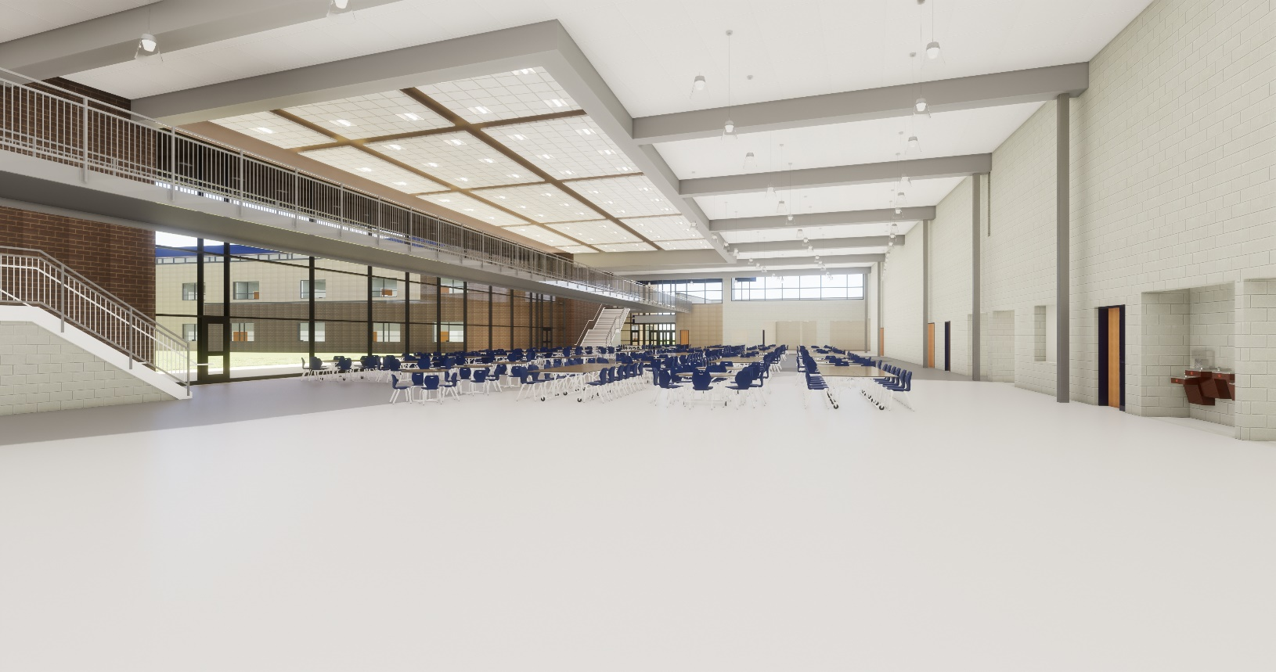
Design Development Phase
1. Civil Engineering:
Site design of vehicular circulation, parking, drop-off areas, pedestrian connections. Land Development submission with storm water management plans.
2. Architectural Plans:
Refinement of Floor Plans, final check of Educational Program, meetings with Faculty to develop Interior layouts, establish Floor Plans to begin design of structural, food service, mechanical, electrical and plumbing systems.
PROJECT EXAMPLES

Slide 11
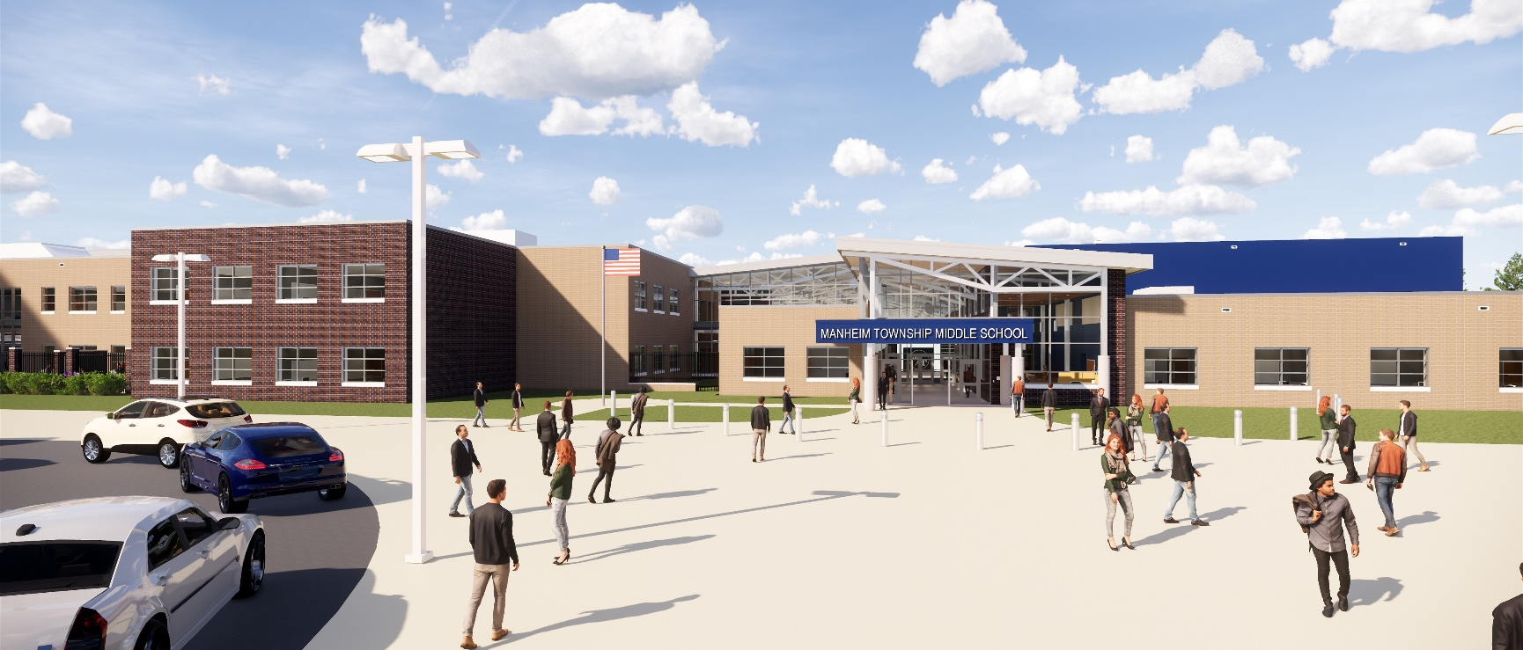
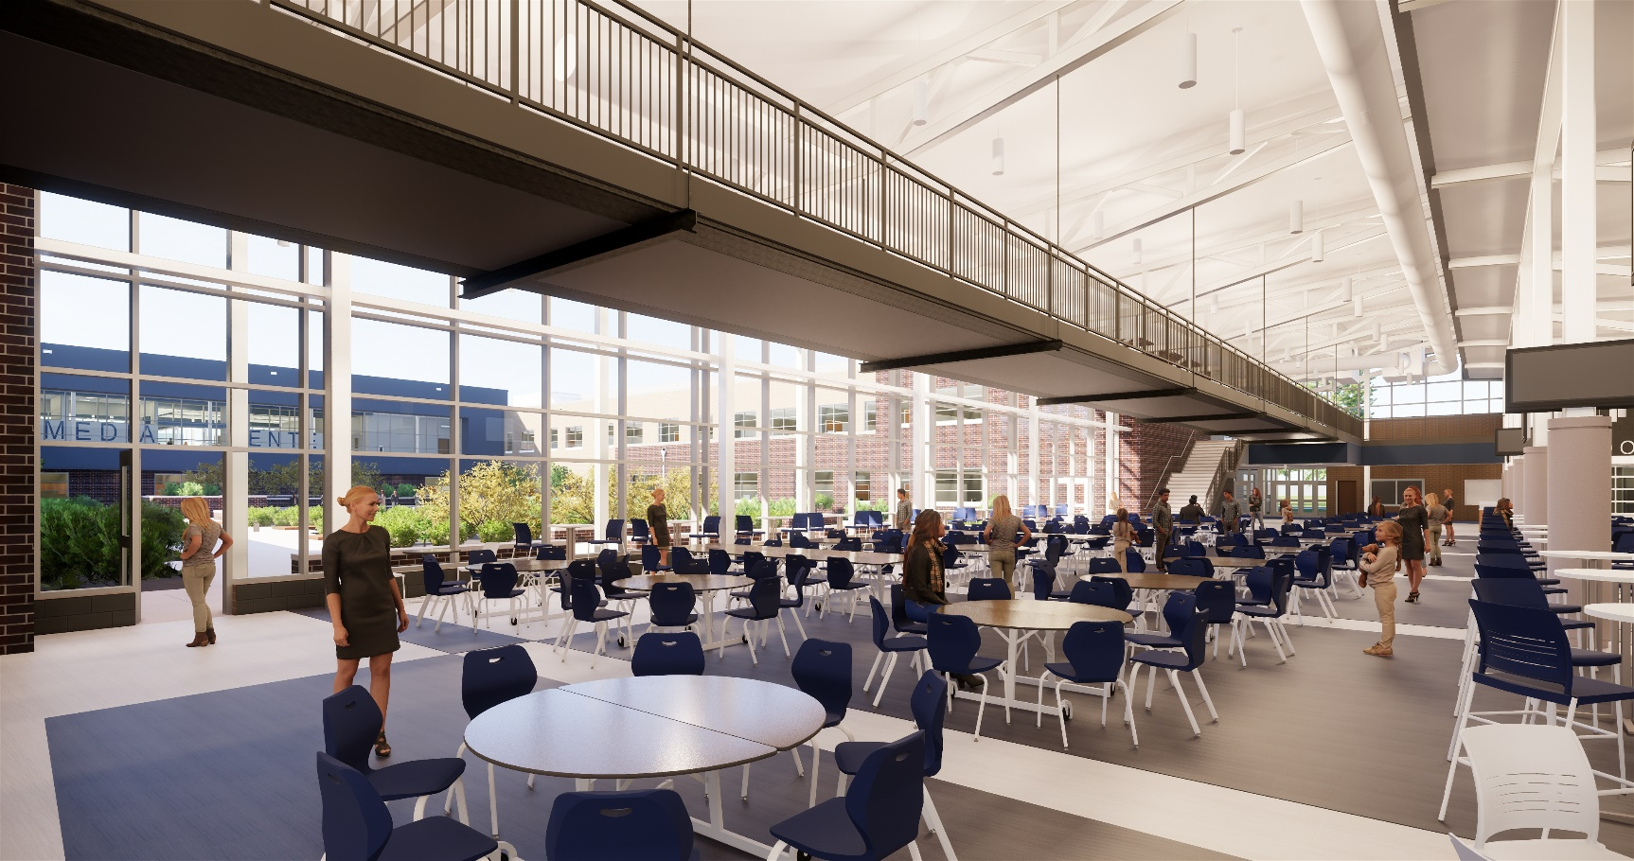
PROJECT EXAMPLES
Construction Documents Phase
1. Civil Engineering:
Acquire necessary permits and approvals required for construction.
2. Architectural Plans:
Final production of Construction Documents with coordination and integration of building systems including structural, food service, mechanical, plumbing, electrical and civil engineering.

Slide 12
3 SCHEMATIC DESIGN

Slide 13
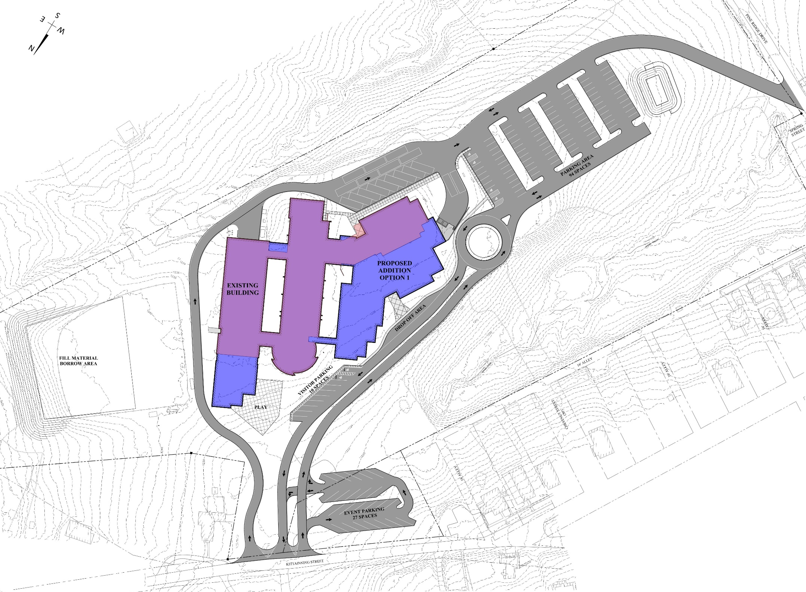
Spring Street Access Drive
Schematic Site Plan
Existing Building
New Addition
Bus Drop-Off
Dock
Staff Parking
Parent Drop-Off
Visitor Parking
Softball/Practice Field
Play Area
Overflow Parking

Slide 14
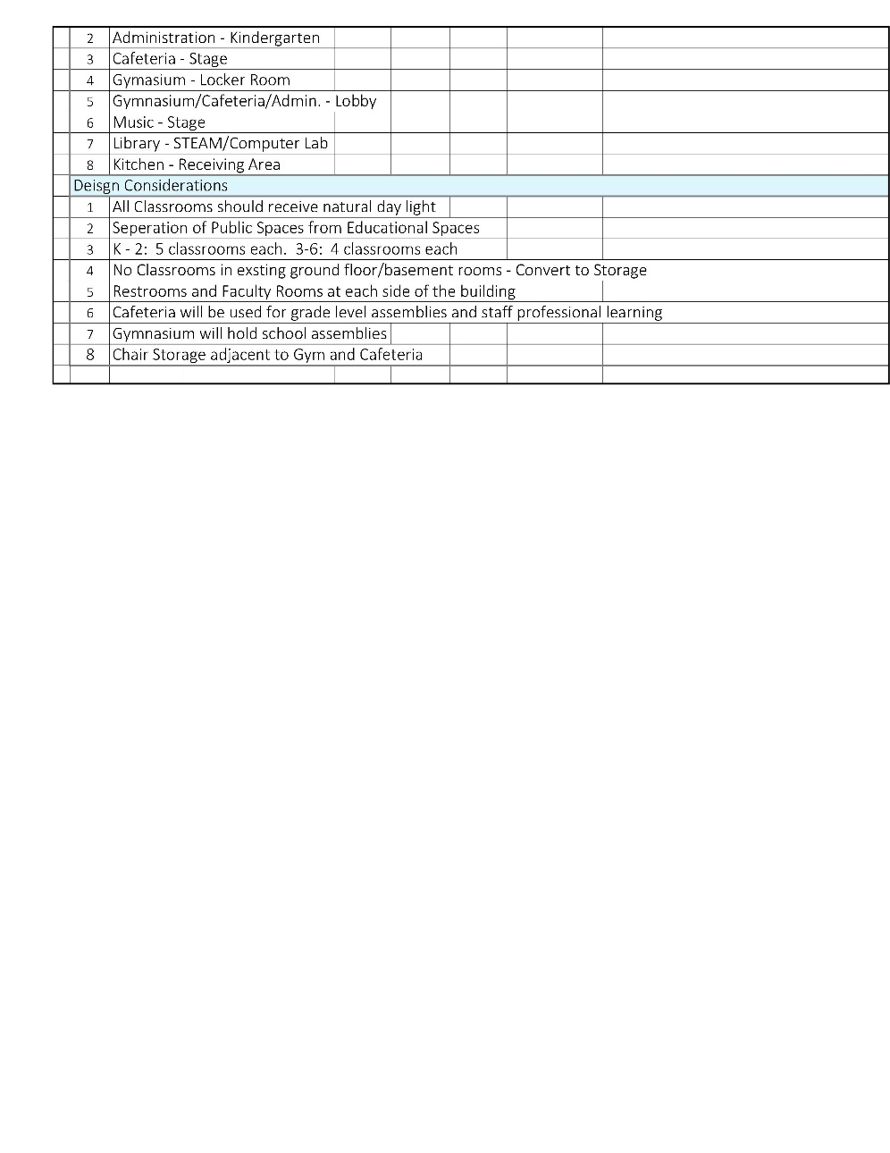
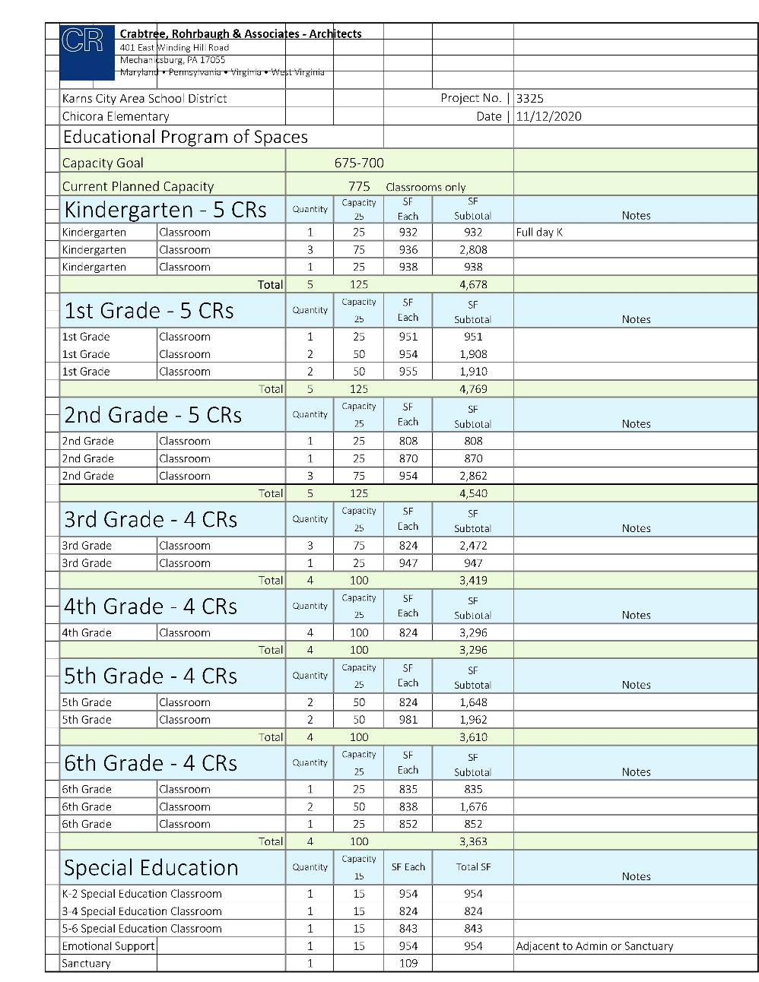
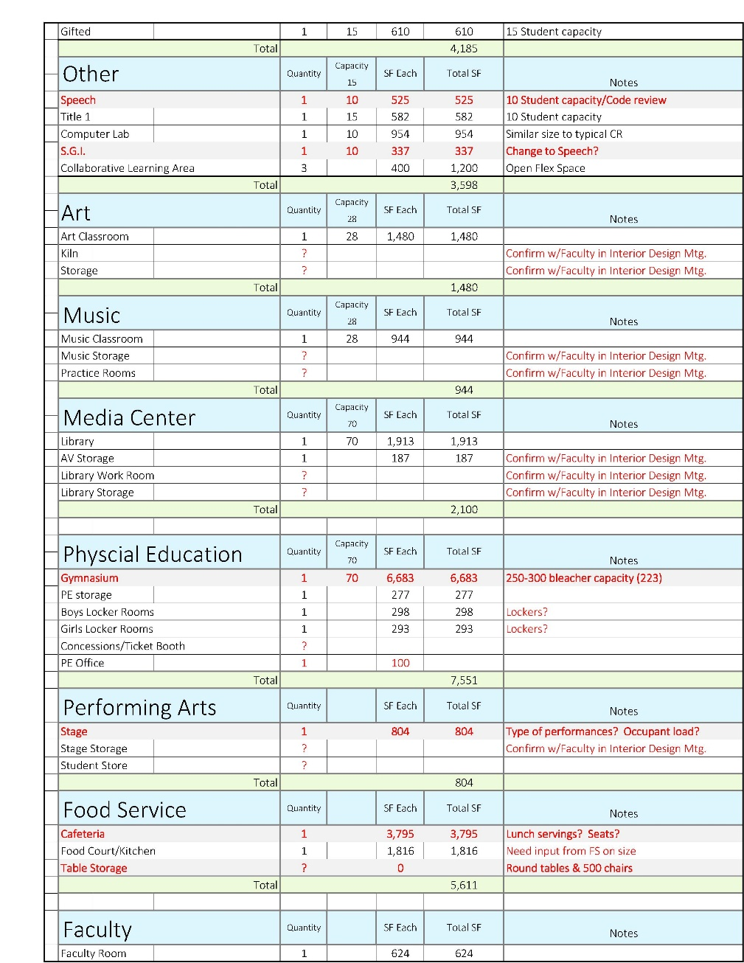
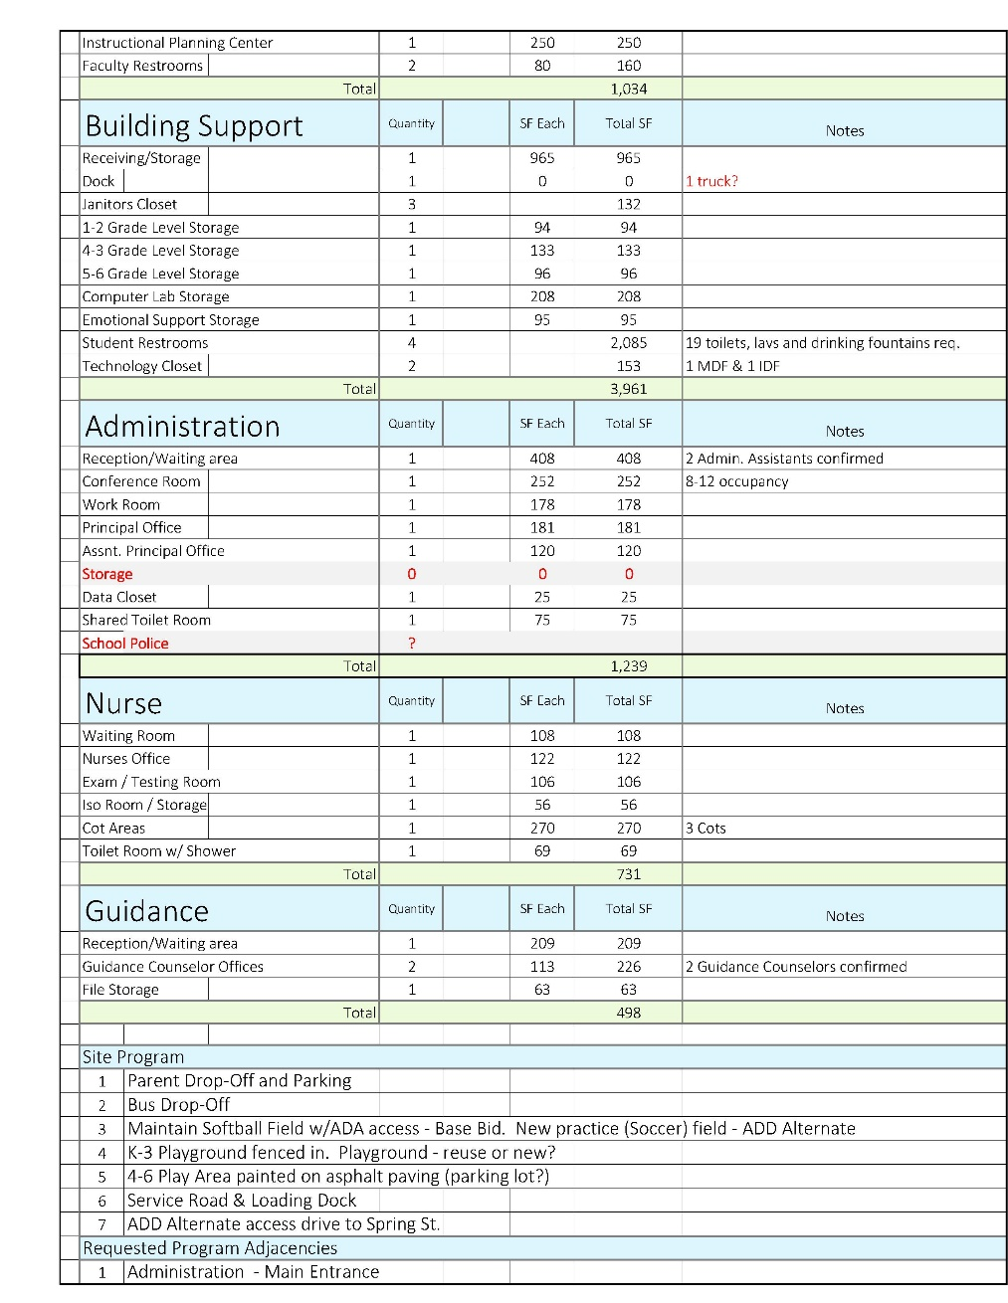
Educational Program
Planned Student Capacity
Quantity and Size of Educational Spaces
Outline of Support Spaces
Needed Adjacencies of Spaces

Slide 15
Schematic Floor Plan
General Classrooms
Special Education
Small Group Instruction
Music
Art
Library/Cafeteria/Gymnasium
Faculty
Building Support
KEY PLAN

Slide 16
QUESTIONS?

